Slide 1
Optimizing Apache Spark
Key Ingestion Concepts
Bucketing

Slide 2
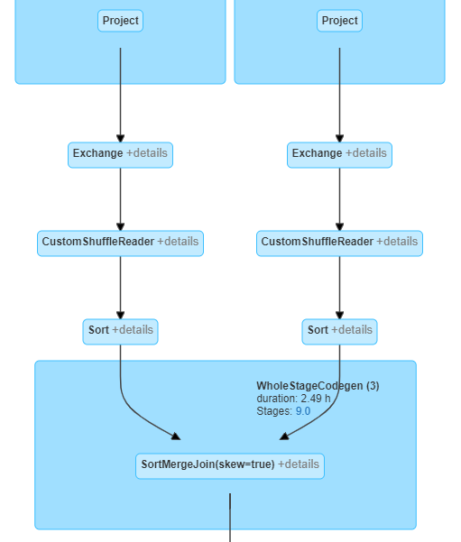
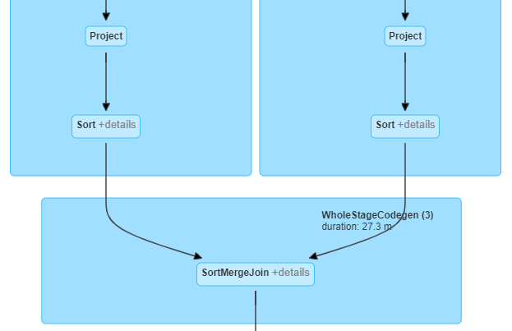
Key Ingestion Concepts
This is done by pre-shuffling the data by column C into N buckets
Bucketing
It also enables predicate push downs by means of the data structure
Recall from earlier, bucketing aims to minimize the effects of a SortMergeJoin by eliminating the exchange and minimizing the sort
Both tables must have the same number of buckets to skip the exchange
They should be reserved for Terabyte scale datasets due to the high network IO
The cost to produce is offset by frequently queried and joined datasets

Slide 3
Key Ingestion Concepts
Predicate Pushdown w/Bucketed Data
Revist Experiment #2934, see Step E
Note the total execution time of the command
In the Spark UI, Query Details
Note the number of files read
Note the filesystem read data size total
Note the filesystem read time
Compared to Step B, Step C & Step D, how is the Physical Plan different?

Slide 4
Key Ingestion Concepts
Predicate Pushdown w/Bucketed Data
Step | Execution Time | number of files read | filesystem read data size | filesystem read time | Physical Plan FileScan | …?
B | ~7 minutes | 100 | 102 GB | ~7 minutes | Includes PushedFilters
C | ~10 seconds | 1 | 285 MB | ~10 seconds | Includes PartitionFilters
D | < 1 minute | 33 | 10.3 GB | ~4 minutes | Includes PushedFilters & DataFilters
E | ~10 seconds | 93 | 314.1 MB | ~10 seconds | Includes PushedFilters & DataFilters
Note: This Bucketed example does not properly showcase its power

Slide 5
Key Ingestion Concepts
Terabyte Join w/Bucketed Data
See Experiment #6167
Contrast Step B (a non-optimized join) with Step D (a bucketed join) on a Terabyte dataset using 4,096 cores
The total execution time
The total number of tasks in the final stage of the final job
From the Spark UI, Summary Metrics, the median Shuffle Read Size / Records
From the Spark UI, Summary Metrics, the median Input Size / Records
The query details of the two stages

Slide 6
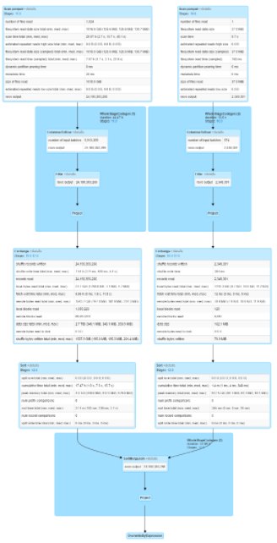
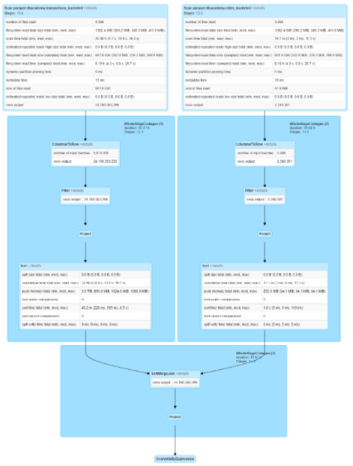
Key Ingestion Concepts
Terabyte Join w/Bucketed Data, Review
Step | Execution Time | Tasks | Median Shuffle Read Size | Median Input Size
B | ~6 minutes | 8,192 | 196 MB | n/a
D | < 1 minute | 4,096 | n/a | 345 MB

Slide 7
Key Ingestion Concepts
Bucketing Prerequisites
Definitely beyond the scope of this course, but here are some key points:
Both sides of the join should employ the same number of buckets to avoid the exchanges and sorts, but it isn’t required
The number of spark partitions will equal the number of buckets
Watch out for skew in the bucketed column & the tiny files problem
To avoid the “Tiny Files” problem, repartition the data by the bucket column
Notes:
The reason for the repartition is to put all records of the same key into the same partition - that way as the files are written to disk, each part file will have like-partitions and thus be grouped together.
Any non-matching keys in a given partition will result in a seperate part-file per the bucketing plan

Slide 8
Key Ingestion Concepts
How to Bucket Data
See in Experiment #6732 how to create a bucketed dataset:
Step E (the transactions table) takes ~10 minutes with 1024 cores
Step G (the cities table) takes another ~30 minutes
And to stress the point, the performance gains of a bucketed dataset are not realized unless the data is going to be queried and joined repetitively

Slide 9
Key Ingestion Concepts
How to Bucket Data - An Example
Here is a quick example of how to bucket an existing dataset:
For a more detail example, see Experiment #6732
spark.read
.parquet(trxSourceDir) // Load the existing dataset
.withColumnRenamed("city_id", "b_city_id") // Advertise the feature by renaming the column
.hint("skew", "b_city_id") // Address the known skew in this dataset
.repartition(numBuckets, $"b_city_id") // Minimizing files-on disk by repartitioning
.write // Write the bucket to disk
.bucketBy(numBuckets, "b_city_id") // Specify the bucketing column
.sortBy("b_city_id") // Sort the bucket to reduce the post-exchange sort
.option("path", trxWriteDir) // A non-managed table - we specify the location
.saveAsTable(trxTableName) // Create the required table

